Slide 1
Tradable salmon quota and other market-based mechanisms to reduce salmon bycatch
Alan Haynie, PhD
Economist, Alaska Fisheries Science Center
Alan.Haynie@noaa.gov
NPFMC Meetings, February 2008, Seattle

Slide 2
Key Messages
A hard cap without some type of salmon bycatch quota has the potential to create a new “race for fish” and could erode benefits of rationalization.
Individual Bycatch Accountability (IBA) mechanisms (quotas or fees) make actors bear the cost of their own bycatch. (Note: quota could be allocated at the coop level.)
A salmon “fee” could be imposed without a hard cap, making fishermen bear the costs of bycatch (and receive the benefits of avoidance). – Legal issues exist about whether this is possible for the Council to implement.

Slide 3
Why consider an IBA measure?
Bycatch is an externality
  Costs and benefits of finding pollock are born by the individual vessel
  “Costs” of bycatch are external to the fishing location choice and the costs are paid collectively
  Costs of bycatch avoidance are inconsistent and inefficient – fishermen don’t know what other fishermen are doing to avoid salmon and are not rewarded for “good” behavior
Tradable salmon quota or a fee on each salmon will ‘internalize’ the externality and force fishermen to consider bycatch costs when choosing where to fish.

Slide 4
IBAs Allow Flexibility in Bycatch Avoidance
IBA measures are market-based tools to reduce bycatch– they allow fishermen to make choices about whether bycatch costs/risks are worth fishing in an area.
  Incentives apply to everyone, always
Whether operated by the managers or industry, an IBA system places clear incentives on fishermen to avoid bycatch.

Slide 5
When are the potential gains from a trading system the largest?
When there is considerable variation of costs, economic values, or opportunities among participants
In our case, the value of bycatch is very different for different vessels and cooperatives

Slide 6
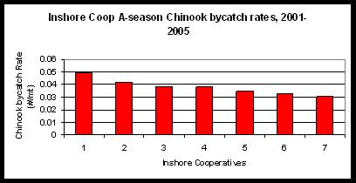
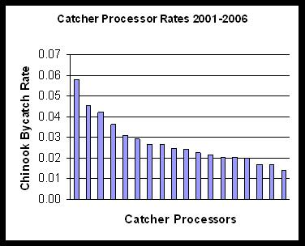
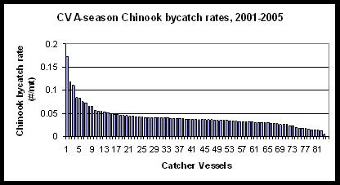
Different Chinook Bycatch Rates Among Pollock Vessels and Coops

Slide 7
Alternative Individual Bycatch Accountability mechanisms
Salmon bycatch quota system
  Only meaningful/effective under a hard cap system
Salmon fee system (likely must be operated by industry because of legal concerns)
  Possible without hard cap
  Fee charged for every salmon caught (challenge: setting the “right” fee to achieve a desired level of bycatch reduction)
  Money could be returned to the pollock fleet or spent on increased research or monitoring
“Hybrid” salmon quota/fee system
  Tradable quota granted up to a certain level
  Fee above that level (if legally acceptable)
  Possible without a rigid hard cap

Slide 8
Challenges to a tradable salmon bycatch system
Seasonal variation in bycatch can be large
  Implication: Difficult for fishermen to predict how much they catch and avoid bycatch during in the season
  Partial solution: Include flexibility mechanisms (discussed later)
Initial bycatch quota allocation
Monitoring

Slide 9
How do we add flexibility to a tradable salmon bycatch quota system?
Council would choose a “quota cap”
Council or Inter-coop could decide on allocation of quota and allocate it to coops or vessels
Trades allowed among coops
10% of quota could be allowed to be “carried over” from one year to another (as in New Zealand and British Columbia, or sablefish/halibut)
To create a “hybrid” quota/fee system: an increasing fee schedule could set by the Council above the quota limit.
  For example, for a vessel’s share of the 5,000 Chinook above the cap, pollock vessels might pay 125% of the market value.
  This percentage would increase with increased catch. If desired, this price can increase steeply to effectively create a more rigid hard cap.
  Similar to the New Zealand deemed value system.

Slide 10
Significant Costs of Status Quo
  Bycatch avoidance and self-management costs for pollock fishery
  High salmon bycatch
  Council efforts and opportunity costs
  Uncertainty for industry on the issue
In other words, IBA is not necessarily more expensive for industry (depends on the level of a fee or hard cap, of course)

Slide 11
Should an individual bycatch accountability system be implemented by Industry or the Council?
Inter-coop could potentially manage a trade/fee system.
A hybrid system with flexibility on the actual number of salmon caught might need Council involvement (legal issues exist here).
There is a significant value of knowing the quota trade price – this essentially lets us know the value of salmon bycatch to the pollock fishery, which will be very useful for future policy decisions.

Slide 12
Initial salmon quota allocation options
Option 1: Allocate based on AFA pollock split to sectors/coops
  Result: Much bigger cost of policy change for inshore fleet
Option 2: Allocate based on historical bycatch by Sector
  Result: Assumes that inshore and offshore vessels have been making comparable efforts to avoid bycatch and have fundamentally different bycatch avoidance costs and opportunities.
Additional Option: Allocate to sectors as in Option 2, but allocate within sectors based on pollock quota.
  Result: Assumes differences between sectors, but does not reward “bad” behavior within sectors. Bycatch avoidance will be more expensive for some vessels than others because of differences in vessels, where they land fish, and personal experience.
Council could invite consensus proposal for quota allocation.

Slide 13
Summary: Four Policy Options
No Hard cap, no IBA
  Status quo
No hard cap, with IBA
  Salmon fee (perhaps managed by industry)
Hard cap, No IBA
  Possible new ‘race for fish’
  We should avoid this outcome!
Hard cap with IBA
  Tradable salmon quota or hybrid system

Slide 14
Other Considerations
Observer challenges– more analysis should be done to evaluate trade-offs of different accounting system for unobserved vessels (e.g., spatially refined bycatch estimates)
Market design is a well-developed branch of economics and can address many of the problems of designing a quota market.

Slide 15
Recommendations for Analysis
Council should analyze a suite of flexible Individual Bycatch Accountability mechanisms
  Hard cap with tradable salmon quota system (and potential carry-over mechanism)
  “Flexible” hard cap with hybrid quota/fee system
  No hard cap, combined with salmon fee
    Legal issues may make this only possible as an industry-operated system.
    Fee could be spent on research or rebated based on pollock catch
To avoid a race for fish, ensure that salmon quota are allocated to coops and allowed to be traded in some manner if a hard cap is implemented.

